Slide 1
Chinook Music Store Analysis
Vasudevan M

Slide 2
Problem Statement​
You are hired as a data analyst at Chinook, and your objective is to analyze music record sales data to gain insights and make recommendations for the company's strategy in the physical music market.​

Slide 3
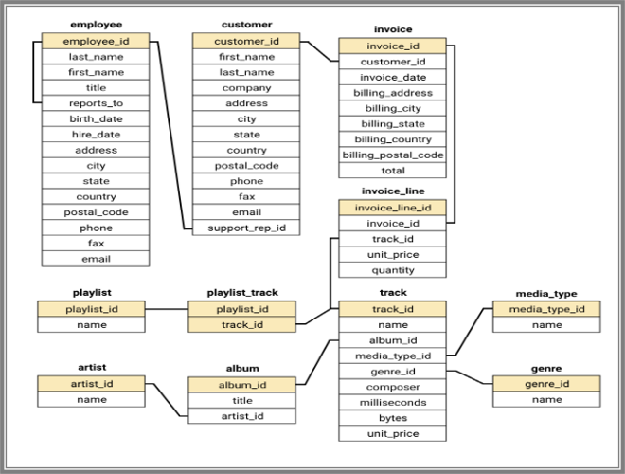
Schema Used​

Slide 4
Table description​
Employee ​ - Stores information about employees, including their ID, name, job title, reporting manager, address, contact information, and employment dates.​
Customer ​ - Stores information about customers, including their ID, name, address, and contact information.​
Invoice ​ - Stores information about invoices, including their ID, date, customer, total, and employee who processed the invoice.​
Invoice Line ​ - Stores information about individual items on an invoice, including the invoice ID, item ID, unit price, and quantity.​
Playlist - Stores information about playlists, including their ID and name.
Playlist Track ​ - Stores information about the relationship between playlists and tracks, including the playlist ID, track ID, and track media type.​
Track ​ - Stores information about tracks, including their ID, name, artist, album, media type, genre, milliseconds, bytes, and unit price.​
Artist ​- Stores information about artists, including their ID and name.​
Album ​- Stores information about albums, including their ID, name, artist, and genre.​
Genre ​- Stores information about genres, including their ID and name. ​ ​ ​
​
​
​

Slide 5
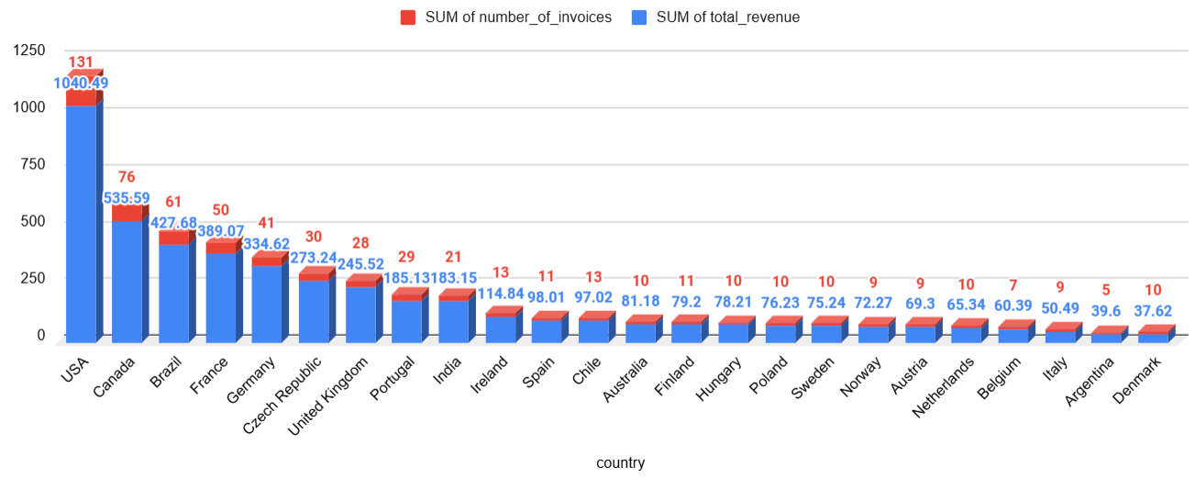
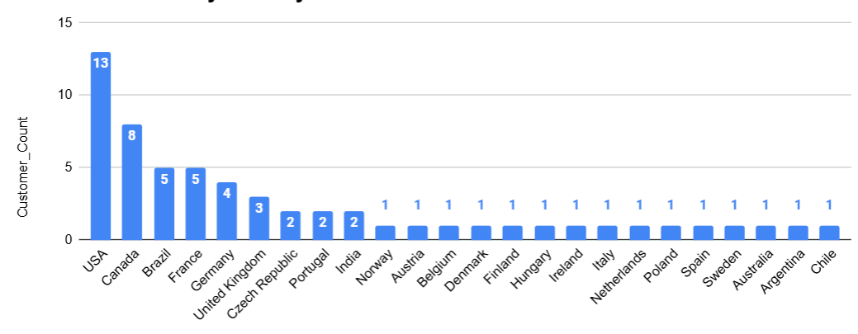
Customer count and Highest Revenue
The USA and Canada have the highest customer counts.
The USA and Canada have the highest total revenue and number of invoices, indicating strong market presence and sales activity in these regions.

Slide 6
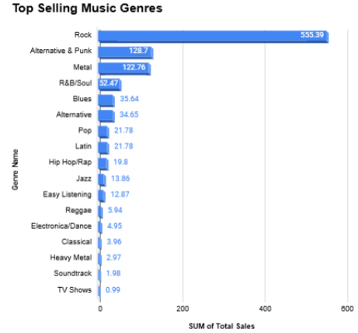
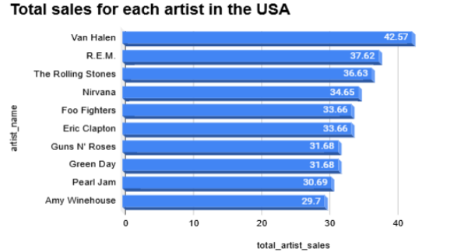
Top artist and Top selling music genres
Rock, Alternative & Punk, and Metal are the top 3 genres that account for over 77% of all music sales, showing their strong market presence.
Van Halen is the top-selling artist with 42.57 in total sales.

Slide 7
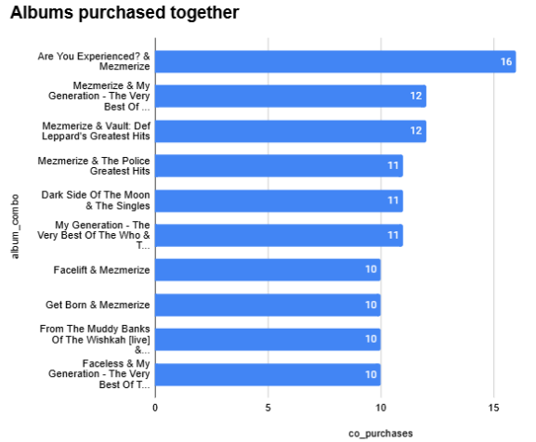
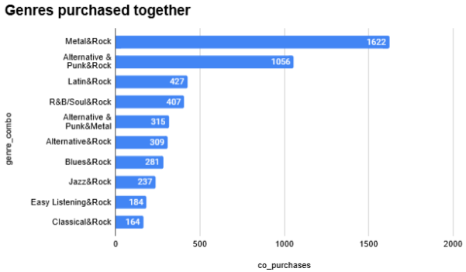
Albums & Genres purchased together
Metal and Alternative & Punk are often purchased together with Rock and even with each other, indicating potential overlap in their fan bases.
Green Day is a central figure appearing in five of the top ten combinations.
Green Day & Led Zeppelin have the highest co-purchase count (24)

Slide 8
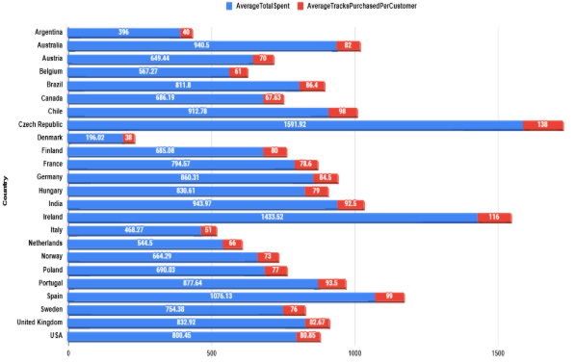
Average Total Spent and Average Tracks Purchased Together by country
The Czech Republic and Ireland exhibit notably higher spending and track purchases.
It highlights the potential for market segmentation, as different countries demonstrate distinct spending and purchasing patterns.
We can cater to the unique characteristics of each market segment.

Slide 9
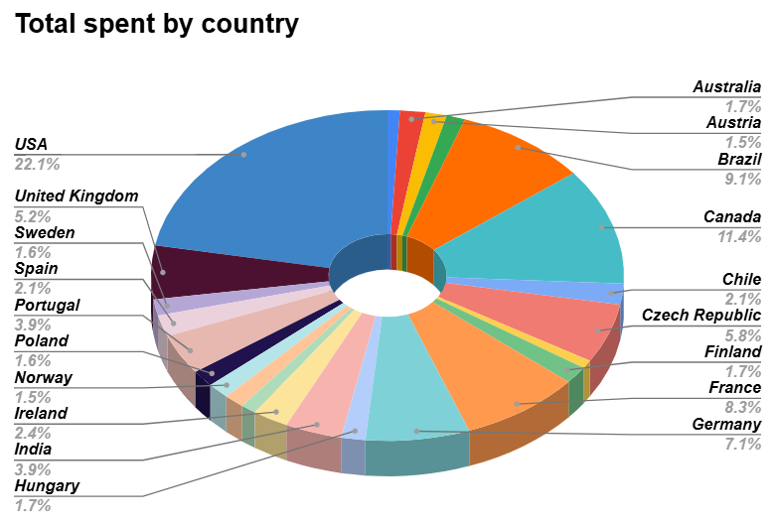
Total spent by country
The USA leads with the total sales, indicating its significance as the largest market.
United Kingdom (5.2%) and Czech Republic (5.8%) show a balanced share, with potential for further growth.
Countries like Australia (1.7%), Norway (1.5%), and Hungary (1.7%) represent small portions

Slide 10
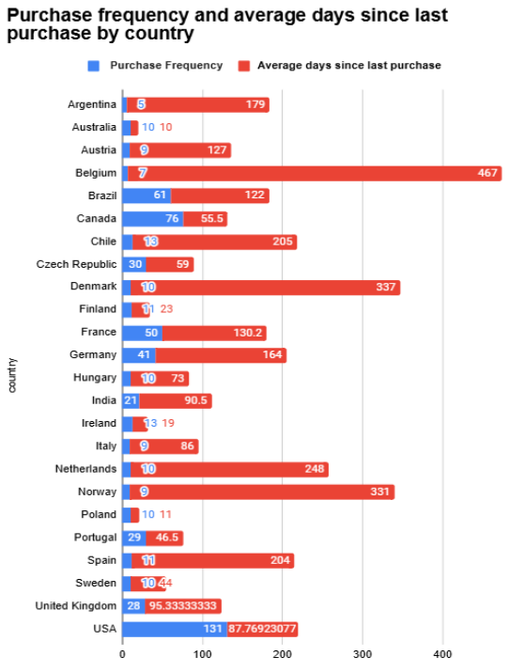
Purchase Frequency by country
USA, Canada, Brazil show high purchase frequency with shorter purchase cycles.
European countries show mixed performance, with promising markets
Belgium, Norway, Denmark are likely to be at higher risk of churn.

Slide 11
Recommendations
Create a monthly subscription box featuring curated physical music selections (e.g., vinyl, CDs, or cassette bundles).
Collaborate with artists and labels to offer exclusive physical releases.
Identify regional preferences for physical music (e.g., Jazz in Europe, Latin genres in South America) and tailor offerings accordingly.
Introduce limited-edition physical albums, including deluxe box sets, signed editions, or colored vinyl.
Use a mix of online platforms (e.g., Amazon, Bandcamp) and physical retail stores, focusing on independent record stores.
Pair physical albums with branded merchandise.
Develop bundles tailored to seasons or events

Slide 12
Conclusion
Prioritize marketing and promotions for top-selling genres like Rock, Jazz, and Pop.
Bundle complementary genres and artists frequently purchased together.
Use targeted campaigns to attract customers who haven’t purchased recently.
Personalized discounts or loyalty rewards could help reduce churn and increase repeat purchases.
Localized marketing strategies targeting high-performing genres in each region can expand Chinook's global footprint.

